Slide 1
Multithreading -
All of you will be familiar with multitasking, all the modern operating systems are multitasking OS. That is they can perform more than one task at the same time (concurrently) for example - while listening music you are writing something in any text editor.
Thread and Multithreading -
Similar to multitasking, multithreaded programs contains two or more parts that's can run concurrently. Each part of such a program is called Thread. And the program is called multithreaded program.And this process is called multithreading.

Slide 2
Difference between Multitasking and Multithreading -
Note that there is a difference between multitasking and multithreading. Multitasking means more than one process (programs) are executing concurrently for example one process or program playing any song and other program or process allows you to surf net on browser.
Whereas Multithreading means one program contains two or more parts executing at the same time for example a text editor program allows you to print and type at the same time.

Slide 3
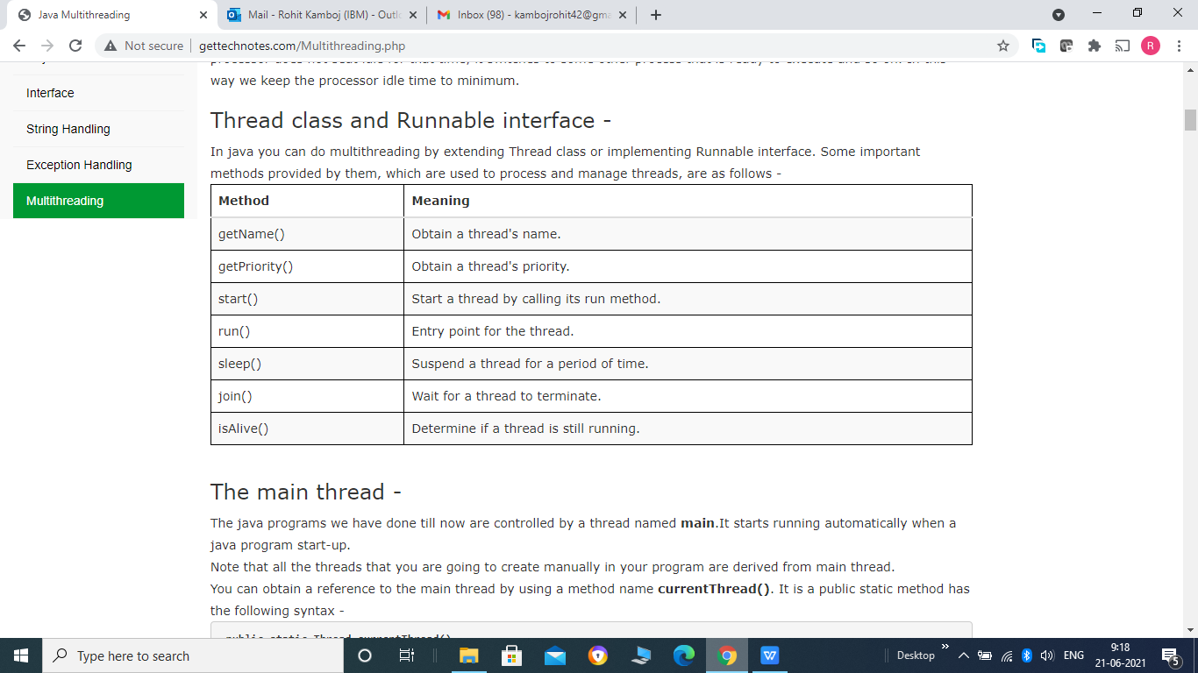

Slide 4
The main thread -
The java programs we have done till now are controlled by a thread named main.It starts running automatically when a java program start-up.
Note that all the threads that you are going to create manually in your program are derived from main thread.
You can obtain a reference to the main thread by using a method name currentThread(). It is a public static method has the following syntax -
public static Thread currentThread()
Once you have a reference to the main thread, you can control it just like any other thread.

Slide 5
Example -
public class Call {
public static void main(String[] args) {
Thread t = Thread.currentThread();
System.out.println("Current thread name : "+t.getName());
}
}
OR
class Demo
{

Slide 6
public void show()
{
Thread t = Thread.currentThread();
System.out.println("Current thread name : "+t.getName());
}
}
public class Call {
public static void main(String[] args) {
Demo d1 = new Demo();
d1.show();
}
}

Slide 7
Creating Thread -
There are 2 ways to create a thread in java -
1- using Thread class.
2- using Runnable interface.
1- Extending Thread class -
A class can create threads by extending thread class and override its run() method. Thread behaviour is implemented by run() methods and it forms the entire body of the thread.
We have to follow the following steps to create thread using Thread class -
Create a class that extends the Thread class.
Override the run() method of Thread class.
Create objects of class and call the start() method, that will start the thread. start() method automatically call the run() method, which contain code of thread.

Slide 8
Example -
class First extends Thread
{
public void run()
{
for(int i=1;i<=5;i++)
{
System.out.println("First "+i);
}
}
}
class Second extends Thread
{
public void run()
{
for(int i=1;i<=5;i++)
{
System.out.println("Second "+i);
}
}
}

Slide 9
class Third extends Thread
{
public void run()
{
for(int i=1;i<=5;i++)
{
System.out.println("Third "+i);
}
}
}
public class Call {
public static void main(String[] args) {
Thread t1 = new Thread(new First());
Thread t2 = new Thread(new Second());
Thread t3 = new Thread(new Third());
t1.start();
t2.start();
t3.start();
}
}

Slide 10
2- Implementing Runnable Interface -
A class can also creates threads by implementing Runnable interface. It also has run() method that defines the behaviour of thread and it has to be implemented by the class.
Example -
class First implements Runnable
{
public void run()
{
for(int i=1;i<=5;i++)
{
System.out.println("First "+i);
}
}
}

Slide 11
class Second implements Runnable
{
public void run()
{
for(int i=1;i<=5;i++)
{
System.out.println("Second "+i);
}
}
}
class Third implements Runnable
{
public void run()
{
for(int i=1;i<=5;i++)
{
System.out.println("Third "+i);
}
}
}

Slide 12
public class Call {
public static void main(String[] args) {
Thread t1 = new Thread(new First());
Thread t2 = new Thread(new Second());
Thread t3 = new Thread(new Third());
t1.start();
t2.start();
t3.start();
}
}

Slide 13
Thread Life Cycle
A thread can have the following states in its lifetime -
New Born state
Runnable state
Running state
Blocked state
Dead state
A thread can move from one state to another in different ways as shown in the below figure -

Slide 14
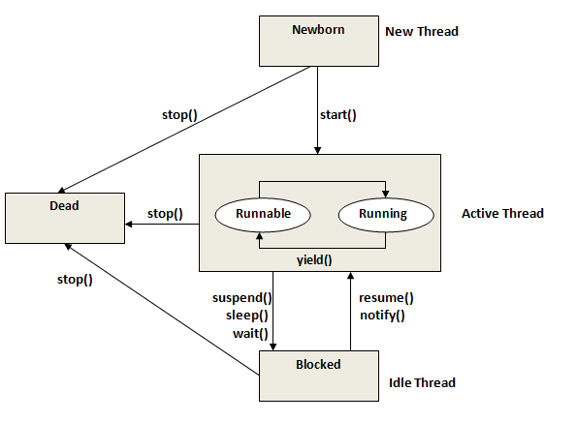

Slide 15
Newborn State -
When we create the object of Thread class (Thread t = new Thread()), thread will be born and called in newborn state. At this stage we can do one of the following things with thread object-
Schedule it for running by calling the start method (t.start()).
Kill it by calling the stop method (t.stop()).
Runnable State -
Thread is said to be in Runnable state when thread is ready to execute by calling start() method but does not get the processor for starting execution. i.e. waiting for the processor.
Running state -
Thread comes in Running state from Runnable state as soon as it gets the processor time and starts executing. At this stage we can do one of the following things with thread -
We can block a thread from running by calling the suspend() method on it. A suspended thread can be revive again by calling the notify() method on it.
We can make a thread sleep for a specified time period by calling the sleep(time) method. Where time will be in milliseconds. Thread will again enter the Runnable state after this specified time period.
We can also told a thread to wait by calling the wait() method. Thread will wait until time specified has elapsed or called the notify() or notifyAll() method. These 3 methods can be called only within a synchronised method, otherwise they will throw an exception.

Slide 16
Blocked State -
By calling the suspend(), wait() or sleep() method we can block a thread i.e. preventing thread from entering into running state. In blocked state thread is not dead and it is fully qualified to run again.
Dead State -
We can kill a thread in two ways - natural death and premature death. When the thread has completed its run() method then it is called natural death. But if we kill a thread by calling the stop() method then it is called premature death.
Using Thread Methods -
We can control the behaviour of thread to some extent by using thread methods such as sleep(), yield(), join(), stop().
Example -

Slide 17
class First extends Thread
{
public void run()
{
for(int i=1;i<=5;i++)
{
System.out.println("First "+i);
if(i == 1)
{
yield();
}
}
}
}
class Second extends Thread
{
public void run()
{
for(int i=1;i<=5;i++)
{
System.out.println("Second "+i);
if(i == 2)
{
stop();
}
}
}
}

Slide 18
class Third extends Thread
{
public void run()
{
for(int i=1;i<=5;i++)
{
System.out.println("Third "+i);
if(i%2 == 0)
{
try
{
Thread.sleep(1000);
}
catch(Exception ex)
{
}
}
}
}
}

Slide 19
public class Call {
public static void main(String[] args) {
Thread t1 = new Thread(new First());
Thread t2 = new Thread(new Second());
Thread t3 = new Thread(new Third());
t1.start();
t2.start();
t3.start();
}
}

Slide 20
Output -
First 1
Second 1
Second 2
Third 1
Third 2
First 2
First 3
First 4
First 5
Third 3
Third 4
Third 5
Observe the output -
First of all t1 thread starts execution and enter the running state. It runs only one time and processor switch over thread t2.
This is because we have called the yield() method on t1 when i became 1, so it will send t1 to runnable state from running state.
t2 runs 2 times and then never executes again because we have called stop() method and it will kill the thread t2.
Next it switch over to thread t3 and runs 2 time and again switch over to other thread, this is because we have called sleep() method on t3 after every 2 runs, So it will send the t3 into runnable state from running state.
Note that sleep() method may throw an InterruptedException and it is a checked exception so we have to handle it.
Also note that we cannot completely control the thread behaviour of threads it may produce some other output in second run.

Slide 21
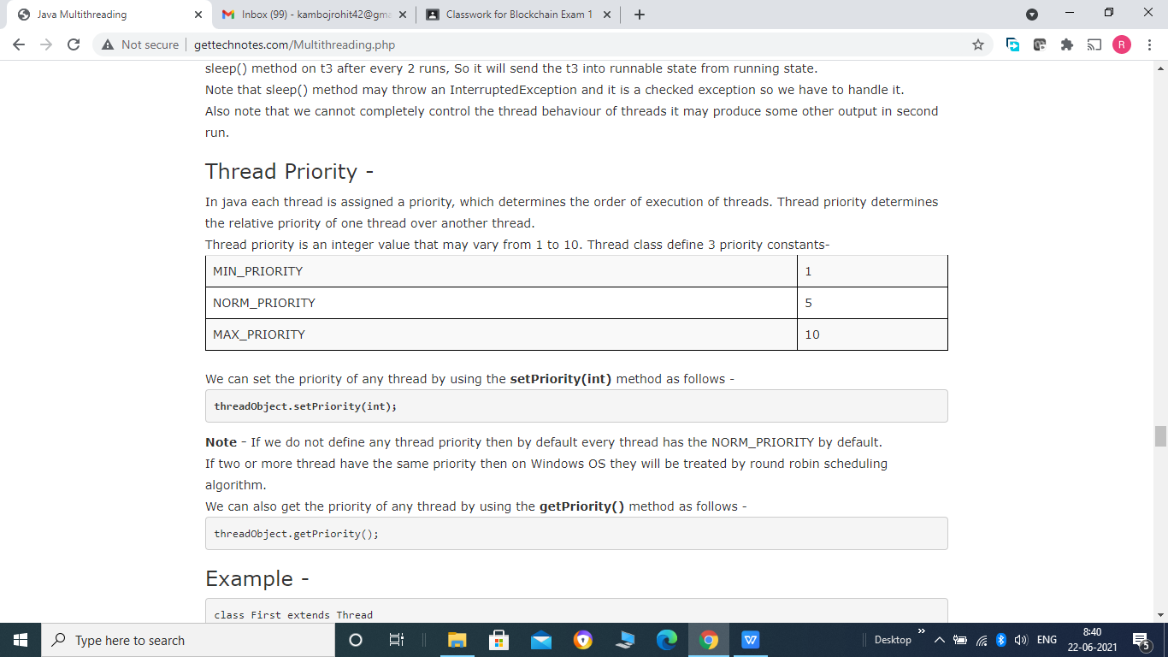

Slide 22
Example -
class First extends Thread
{
public void run()
{
for(int i=1;i<=5;i++)
{
System.out.println("First "+i);
}
}
}
class Second extends Thread
{
public void run()
{
for(int i=1;i<=5;i++)
{
System.out.println("Second "+i);
}
}
}

Slide 23
class Third extends Thread
{
public void run()
{
for(int i=1;i<=5;i++)
{
System.out.println("Third "+i);
}
}
}
public class Call {
public static void main(String[] args) {
Thread t1 = new Thread(new First());
Thread t2 = new Thread(new Second());
Thread t3 = new Thread(new Third());

Slide 24
t1.setPriority(Thread.MIN_PRIORITY);
t2.setPriority(Thread.MAX_PRIORITY);
t3.setPriority(t1.getPriority()+1);
t1.start();
t2.start();
t3.start();
}
}

Slide 25
Output -
First 1
Second 1
Second 2
Second 3
Third 1
Second 4
Second 5
Third 2
Third 3
Third 4
Third 5
First 2
First 3
First 4
First 5
Note that t1 thread start first but it is prompted by t2 because t2 has higher priority than t1 and later on t3 has been assigned the highest priority so it takes control over the t1 and t2.
Always remember that thread priority also depends upon several other OS factors too. So assigning highest priority to any thread does not guarantee that it will run first.

Slide 26
Synchronization -
If two or more threads wants to access to a shared resource at the same time and the recourse is such that it may produce some incorrect result if accessed concurrently(for example one thread try to read a record from a file while another is still writing to the same file ). In such case there should be some way to ensure that only one thread can access the resource at the same time. The process by which this is achieved is known as synchronization.
We can synchronize any resource (code) in two ways -
1- Synchronizing methods.
2- Synchronizing statements (objects).
First of all let's look at what problems may occur if multiple threads want to access a shared resource. Consider the following example -

Slide 27
class Test implements Runnable
{
private int points =10;
public void run()
{
calculatePoints();
}
public void calculatePoints()
{
if(points > 0)
{
System.out.println("You got 5 points");
points = points - 5;
System.out.println("Points left :"+points);
}
else
{
System.out.println("No points left");
}
}
}

Slide 28
public class Call {
public static void main(String[] args) {
Test tst = new Test();
Thread t1 = new Thread(tst);
Thread t2 = new Thread(tst);
Thread t3 = new Thread(tst);
t1.start();
t2.start();
t3.start();
}
}

Slide 29
Output -
You got 5 points
You got 5 points
You got 5 points
Points left :0
Points left :-5
Points left :-5
Note that we have 10 points in total but it prints "You got 5 points" 3 times, i.e. 15 points.
This is because all the threads are accessing the calculatePoints() method concurrently and while it was accessed by one thread, in the middle, the second thread pre-empted the first one and so on. That is why it is giving incorrect results.
So in such situation it is necessary that if one thread is accessing a shared resource, then no other thread should be able to access that resource until it was free by first one. And in java it is archived by synchronization.
Consider the following example -

Slide 30
1- Synchronizing methods -
class Test implements Runnable
{
private int points =10;
public void run()
{
calculatePoints();
}
synchronized public void calculatePoints()
{
if(points > 0)
{
System.out.println("You got 5 points");
points = points - 5;
System.out.println("Points left :"+points);
}
else
{
System.out.println("No points left");
}
}
}

Slide 31
public class Call {
public static void main(String[] args) {
Test tst = new Test();
Thread t1 = new Thread(tst);
Thread t2 = new Thread(tst);
Thread t3 = new Thread(tst);
t1.start();
t2.start();
t3.start();
}
}

Slide 32
Output -
You got 5 points
Points left :5
You got 5 points
Points left :0
No points left
In this case if thread t1 is accessing the method first then it cannot be accessed by t2 or t3 until it has been freed by t1.i.e only one thread can access the method at a time.

Slide 33
2- Synchronizing statements (objects) -
class Demo
{
private int points = 10;
public void calculatePoints()
{
if(points > 0)
{
System.out.println("You got 5 points");
points = points - 5;
System.out.println("Points left :"+points);
}
else
{
System.out.println("No points left");
}
}
}

Slide 34
class Test implements Runnable
{
Demo d1 = new Demo();
public void run()
{
synchronized(d1)
{
d1.calculatePoints();
}
}
}
public class Call {

Slide 35
public static void main(String[] args) {
Test tst = new Test();
Thread t1 = new Thread(tst);
Thread t2 = new Thread(tst);
Thread t3 = new Thread(tst);
t1.start();
t2.start();
t3.start();
}
}

Slide 36
Output -
You got 5 points
Points left :5
You got 5 points
Points left :0
No points left

